Slide 1


Apple M1 CPU
Qumru

Slide 2
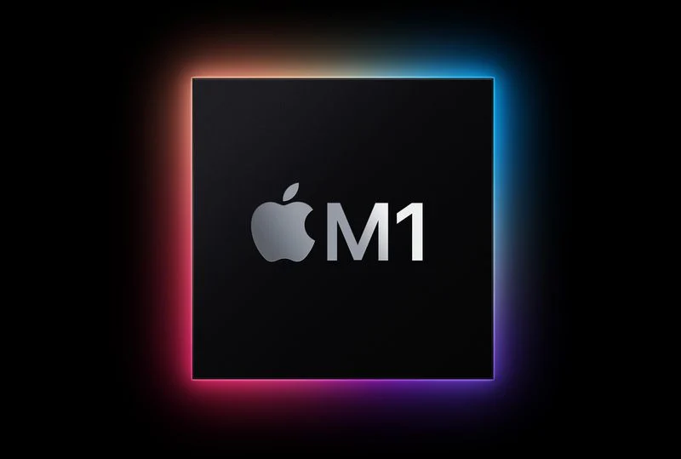
Apple M1 Chip: Everything You Need to Know
Apple in November 2020 released the first Macs with an Arm-based M1 chip, debuting 2020 13-inch MacBook Pro, MacBook Air, and Mac mini models. In early 2021, Apple added the M1 iMac and the M1 iPad Pro. The M1 chip has received rave reviews for its incredible performance and efficiency, and it is the culmination of more than a decade of Apple's work on chips created for the iPhone and the iPad.

Slide 3
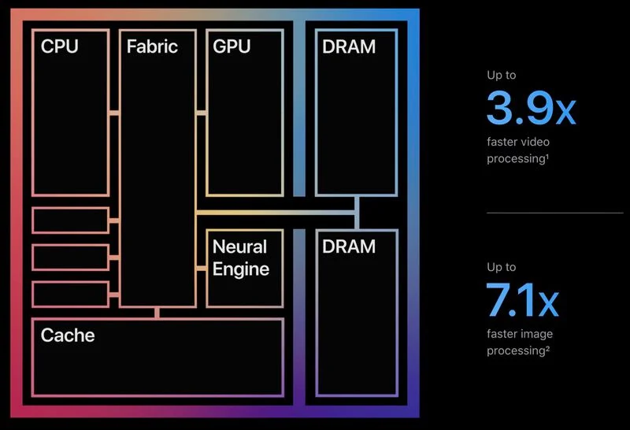
Apple's M1 Chip Explained
The M1 was the first Apple-designed System on a Chip (SoC) that's been developed for use in Macs. It marked Apple's first step toward transitioning away from the Intel chips that the Cupertino company used in Macs since 2006. As a "System on a Chip," the M1 integrates several different components, including the CPU, GPU, unified memory architecture (RAM), Neural Engine, Secure Enclave, SSD controller, image signal processor, encode/decode engines, Thunderbolt controller with USB 4 support, and more, all of which power the different features in the Mac.
Before Apple silicon, Macs used multiple chips for CPU, I/O, and security, but Apple's effort to integrate these chips is the reason why the M1 is so much faster and more efficient than prior Intel chips. The unified memory architecture that Apple has included is also a major factor because all of the technologies in the M1 are able to access the same data without having to swap between multiple pools of memory.

Slide 4
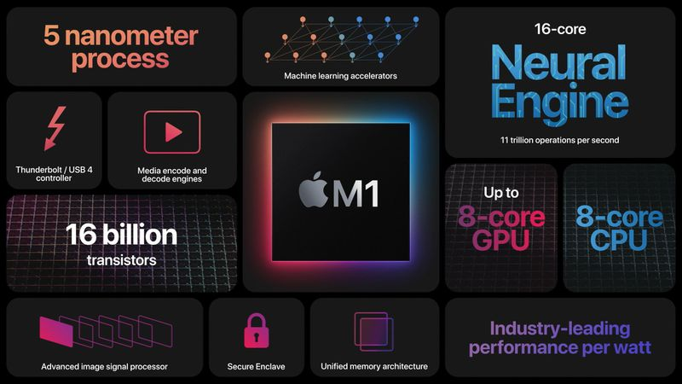
What's Different About the M1
Unlike Intel chips built on the x86 architecture, the Apple Silicon M1 uses an Arm-based architecture much like the A-series chips that Apple has been designing for iPhones and iPads for years now.
The M1 chip is the most powerful chip that Apple has created to date, and it is similar to the A14 chip in the latest ‌iPhone‌ and iPad Air models, built on a 5-nanometer process by Taiwan Semiconductor Manufacturing Company (TSMC). TSMC builds all of Apple's chips and has done so for many years.

Slide 5
Macs With M1 Chip & CPU
Apple has released the 2020 ‌MacBook Air‌, 13-inch MacBook Pro, and ‌Mac mini‌ with M1 chips, replacing the low-end machines in those lineups. Apple has also introduced M1 versions of the ‌iMac‌ and the ‌iPad Pro‌.
The M1 chip includes an 8-core CPU with four high-performance cores and four high-efficiency cores. The high-performance cores are designed to offer the best performance for power-intensive single-threaded tasks. The four high-performance cores can work together to offer impressive multithreaded performance that has allowed the M1 Macs to outshine even the highest-end 16-inch MacBook Pro models. Apple says these cores offer performance similar to the prior-generation dual-core ‌MacBook Air‌, but at much lower power. These cores can work alone when significant power isn't needed, but for demanding tasks, all eight cores can be engaged at one time.
Benchmarks of the ‌MacBook Air‌, MacBook Pro, and ‌Mac mini‌ have confirmed the M1 chip's impressive performance. There are some thermal differences between the models, but all have the highest single-core performance out of any Mac and multi-core performance on par with Apple's desktops.

